Slide 1
Predicting Movie Success with datamining
Povilas Kubilius
C16370803
DT228

Slide 2
Project IDEA
The main idea for this project is to predict movie’s ratings and box office income before the movie is made.
Train an artificial neural network to predict movie success
Create interactive web application to predict movie success using the prediction model

Slide 3
Research
Cinelytic, ScriptBook and VaultAI
Movie Success Prediction using Data Mining by Saurabh Kumar
- Data from IMDb
- Correlate movie ratings with actors, budget, genre and release date
- Accuracy of up to 80%
Other papers using liner regression and SVM
- Accuracy of 60% -70%

Slide 4
System Design
Web scraping
Dataset
Training Neural Network to create prediction model
Web Application
3-tier client/server/database architecture

Slide 5
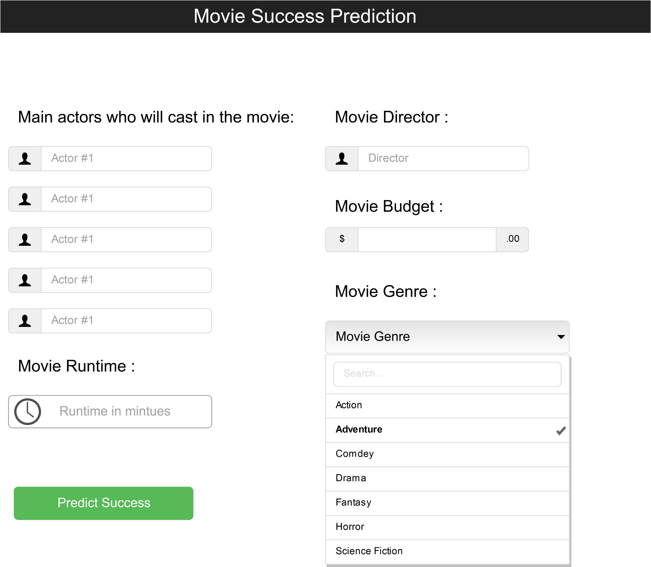

Slide 6
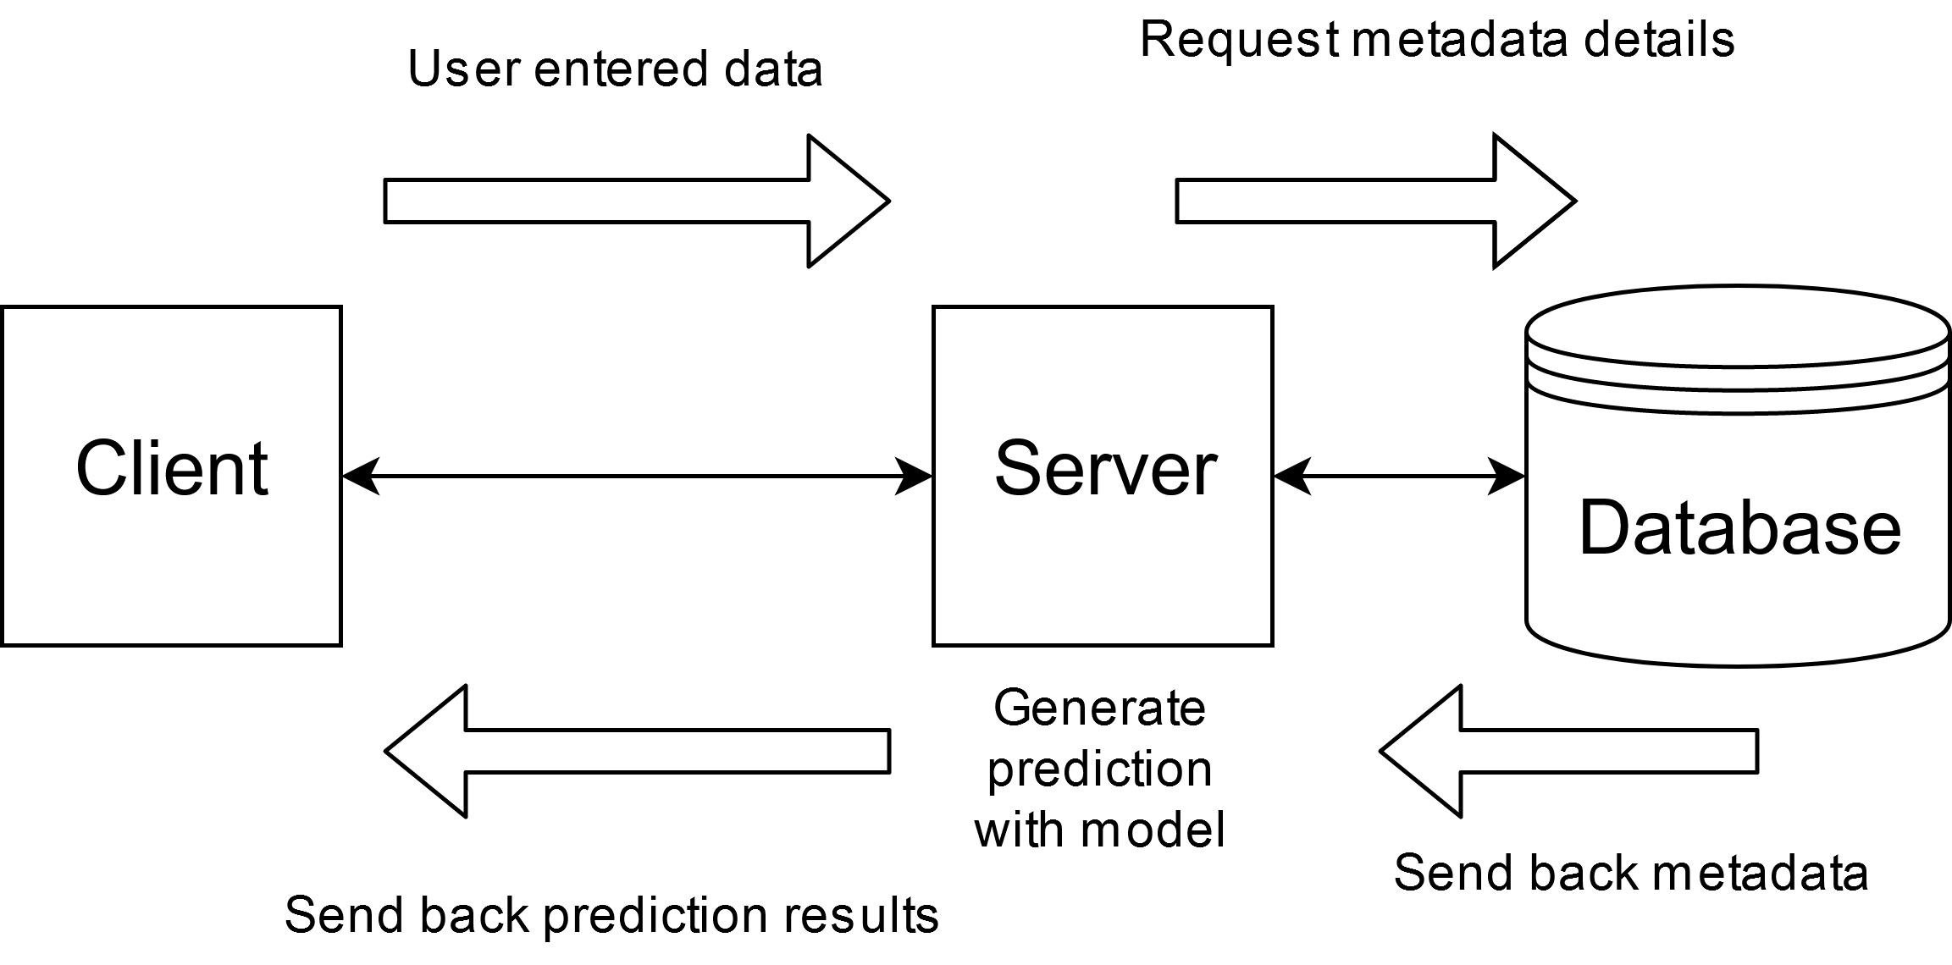
System Architecture

Slide 7
Technologies Used
Python and Python Libraries
TensorFlow
Django web frame
MySQL
HTML/CSS and JavaScript

Slide 8
Project Complexity
Artificial Neural Networks
Accuracy in prediction
Web scraping and data cleaning
Web application

Slide 9
Testing
White Box
Black Box
Testing Neural Network
User Evaluation

Slide 10
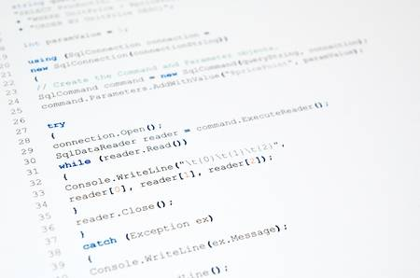
DEMO

Slide 11
Future Work
Use web scraping to complete datasets
Implement Django Server
Implement website front-end
Implement MySQL database back-end

Slide 12

Questions

